Slide 1
Branching, while, CLI
if statements, Loops, and Commandline Interface

Slide 2
Lesson #3 Learning Outcomes
Boolean Datatype
Relational Operators
if statements (if, if else, and if elif else)
Logical Operators
Boolean expression
Indefinite Iteration (while loop)
Command Line Interface (CLI)

Slide 3
Boolean
So far we have worked with int, float and str(string) data types.
Boolean is a data type that has two values: True and False.
The uppercase first letters are important.
Boolean variables can hold either True or False values (these are boolean values, not Strings).
Boolean variables can be used as flags
A flag is a variable that signals when some condition is met.

Slide 4
Boolean Expression
Boolean expression is a comparison expression that would produce either True or False.
Relational operators can be used in boolean expressions.

Slide 5
Relational Operators
Relational operators are used to compare between values and evaluate to True or False.
Relational operators can be used to compare between numbers or strings.
Relational Operator | Description | Example (a = 3 , b = 4 )
< | a < b means a is less than b | a < b ➔ True a < 2 ➔ False
> | a > b means a is greater than b | b > a ➔ True a > b ➔ False
<= | a <= b means a is less than or equal to b | a <= b ➔ True a <= 3 ➔ True a <= 2 ➔ False
>= | a >= b means a is greater than or equal to b | b >= a ➔ True b >= 4 ➔ True b >= 5 ➔ False
== | a == b means a is equal to b | a == 3 ➔ True a == b ➔ False
!= | a != b means a is not equal to b | a != b ➔ True a != 3 ➔False

Slide 6
Relational Operators
Note that = and == are different symbols
= is an assignment operator; assign the value on the right to the variable on the left
== is equality comparison operator that evaluates to True or False
number = 5 assigns the value 5 to the variable number
number == 5 True or False; does variable number have the value 5?

Slide 7
if Statement
So far we have seen sequential execution of the statements.
Statements are executed one after the other in the order in which they appear:
a()
b()
c()
Sometimes the behaviour of program needs to change depending on a certain condition.
If statements are used to check conditions and change the behaviour of the program accordingly; they can be used to skip code sections, or to select one section out of many:
a()
if something is True:
b() # b may or may not be executed
c()

Slide 8
if statement
General syntax:
if Boolean expression:
statement
statement
etc.
The statements will execute ONLY IF the result of the Boolean expression is True.

Slide 9
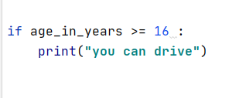
if Statement
Example:

Slide 10
if else Statement
A second if statement form exists for two possibilities:
Do one path if the statement is True;
Do the other path if the statement is False.
General Syntax:
if Boolean expression :
statement(s) to do because the “if” is True
else:
statement(s) to do because the “if” is False

Slide 11
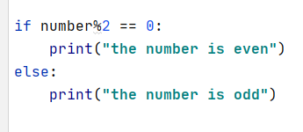
if else Statement
Example:

Slide 12
if else Statement
first_name = "jason"
age_in_years = 12
if age_in_years >= 16:
print("you are old enough to drive")
print("be safe")
print("have fun")
print("don't speed")
else:
print("you are not old enough to drive")
print("you have to wait %d more years %s!!!" % (16 - age_in_years, first_name))

Slide 13
if else Statement
When you write an if-else statement, follow these guidelines for indentation:
Make sure the if block and the else block are aligned (same level of indentation).
The if block and the else block are each followed by a colon and then an intended block of statements.
Make sure the statements inside each block are consistently indented.

Slide 14
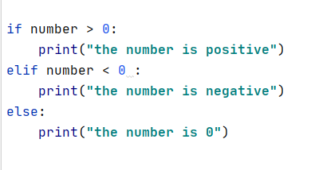
Chained conditionals (if / elif / else)
Sometimes there are more than two possibilities, so we need more than two branches.
Example:

Slide 15
Chained conditionals (if / elif / else)
first_name = "jason"
age_in_years = 16
if age_in_years > 16:
print("you are old enough to drive")
print("be safe")
print("have fun")
print("don't speed")
elif age_in_years == 16:
print("you are barely old enough to drive")
print("go take some lessons")
else:
print("you are not old enough to drive")
print("you have to wait %d more years %s!!!" % (16 - age_in_years, first_name))

Slide 16
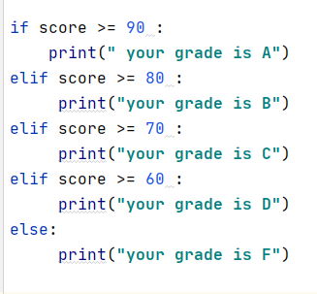
if/ elif/ else
elif is an abbreviation of else if.
Ultimately exactly one branch will be executed and the rest will be skipped.
There is no limit to the number of elif branches.
Example:

Slide 17
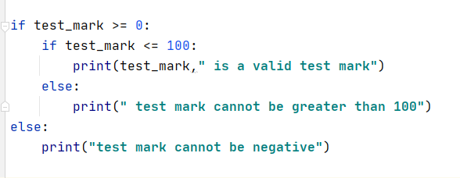
Nested if statements
If statements can be nested to implement complex logic
Example:
To validate that a test mark is between
0 and 100 inclusive:
But do not indent too many times. That code is too complex to follow.

Slide 18
Distinct if Statements
Each if statement whether it is an if or if/else or if/elif/else statement is considered one decision making statement.
The first branch that returns true will be executed and the other branches will be ignored.
Multiple distinct if statements are multiple decisions because each if statement will be evaluated individually and the branch that returns true of every if statement will be executed.

Slide 19
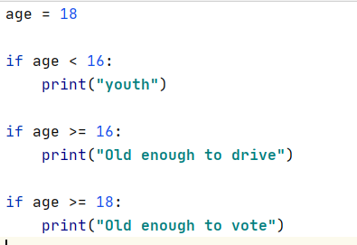
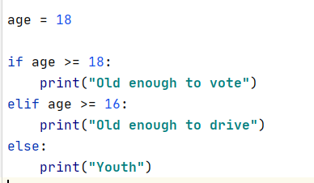
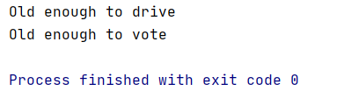

Distinct if Statements
Example:
On the left, all three if’s are evaluated always
On the right, it runs until one is True then stops

Slide 20
Logical Operators
Python provides a set of operators known as logical operators:
and, or, not
Boolean operators can be used to create complex Boolean expressions.
Assuming that P and Q are two Boolean variables:
P | Q | P and Q | P or Q | not P
False | False | False | False | True
False | True | False | True | True
True | False | False | True | False
True | True | True | True | False

Slide 21
Logical Operators: and, or, not
Boolean Operator | Description | Example (Assume x = 3, y = 2)
P and Q | Boolean AND: True when and only when both operands are True. | x == 3 and y == 2 is True x == 3 and y == 3 is False
P or Q | Boolean OR: False when and only when both operands are False. | x == 3 or y == 3 is True x == 2 or y == 2 is True x == 1 or y == 1 is False
not P | Boolean NOT (opposite): True when the single operand is False (and False when operand is True).​ | not (x == 3) is False not (y == 3) is True

Slide 22
Logical Expressions – Order of Operations
Precedence Rules – the order in which operators are evaluated in an expression.
Operator/Convention | Description
( ) | Items within parentheses are evaluated first
* / % + - | Arithmetic operators (using their precedence rules; see earlier section)
< <= > >= == != | Relational, (in)equality, and membership operators
not | not (logical NOT)
and | Logical AND
or | Logical OR

Slide 23
Short-Circuit Evaluation
Python evaluates if statement boolean expression from left to right.
Sometimes evaluating the left part is sufficient to determine the end result therefore the right part will not be evaluated.
This is called Short-Circuit Evaluation.

Slide 24
Short-Circuit Evaluation: and
Example:
if (5 > 10 and 7 > 0) :
The first(left) part of the if statement results in False therefore, the second part will not be evaluated because
False and anything results in False

Slide 25
Short-Circuit Evaluation: or
Similarly,
if (5 < 10 or 7 < 0):
the first(left) part of the if statement expression results in True therefore, the second part will not be evaluated because
True or anything evaluates to True.
if (7 < 0 or 5 < 10):
Both expressions must be evaluated.

Slide 26
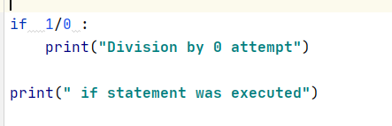
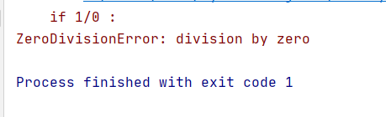
Short-Circuit Evaluation
Running the following code :
Result :

Slide 27
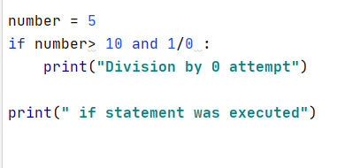
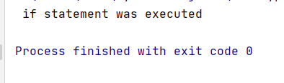
Short-Circuit Evaluation
Running the following code:
Result:

Slide 28
Repetition Statements: while loop
if conditional statement:
do this
do that
do this too
while conditional statement:
do this
do that
do this too
A while loop is a self-repeating if statement

Slide 29
Repetition Statements: while loop
A block of code inside an “if statement” gets executed zero times, or one time.
A block of code inside a “while statement” gets executed zero times, one time, … 500 times, … infinity times. It depends on the logic.

Slide 30
Repetition Statements: while loop
Many algorithms require executing a set of statements repetitively; these statements are called loops.
Python provides two types of loops: Condition-controlled and Count-controlled.
Condition-controlled loop is called a “while loop”.
A “while-loop” allows you to repeat a block of code as long as the condition is True.

Slide 31
Repetition Statements: while loop
The condition is given before the loop body.
The condition is checked before each execution of the loop body; it is like a self-repeating if statement.
Typically, the while loop is used when it is impossible to determine the exact number of loop iterations in advance.
General Syntax:
while <condition>:
block of code

Slide 32
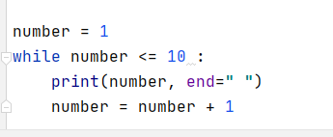

Repetition Statements: while loop
Example: to display the numbers from 1 to 10:
Output:

Slide 33
Repetition Statements: while loop
# print the even numbers from 1 to 100
i = 1
while i <= 100:
if i % 2 == 0:
print(i)
i += 1 # or i = i + 1

Slide 34
Repetition Statements: while loop
This is how the while loop is executed:
number = 1
print(number)
number = number + 1
while number <= 10:
the condition will be checked,

Slide 35
Repetition Statements: while loop
This is how the while loop is executed:
number = 1
while number <= 10:
the condition will be checked
print(number)
if True the while block(body) runs
number = number + 1

Slide 36
Repetition Statements: while loop
This is how the while loop is executed:
number = 1
while number <= 10:
After the last statement of the while block is executed, the computer goes back to the condition and checks it again.
print(number)
number = number + 1
If True the while block(body) runs, if it is false the while loop stops.

Slide 37
Infinite Loop
An infinite loop occurs when a program keeps executing within one loop, never leaving it.
This happens if the condition will never be False.
Example:
number = 1
while number <= 10:
print(number)

Slide 38
Stopping a while Loop
The while loop condition should eventually evaluate to False.
Use break statement to terminate the loop; the flow of control will jump to the statement directly after the while loop.
Use exit() to terminate the program (note: this is rarely used).
Use return to exit from a function.
Use continue to skip the rest of the current iteration of a while loop.

Slide 39
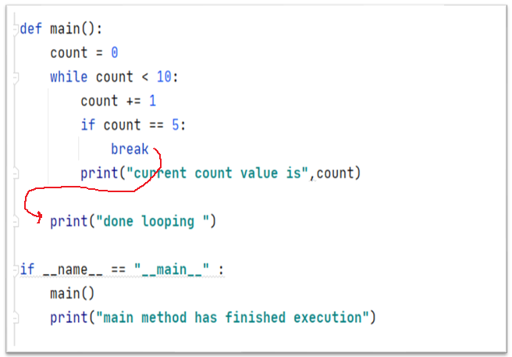
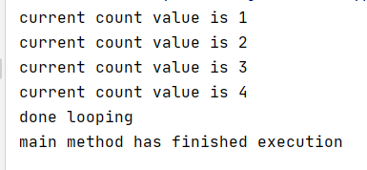
Stopping a while Loop
Example of using break statement to stop the loop before printing 5:
Output:

Slide 40
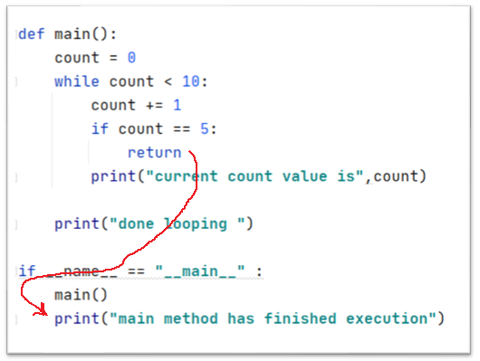
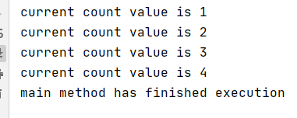
Stopping a while Loop
Example of using return statement (inside a function), which stops the entire function running:
Output:

Slide 41
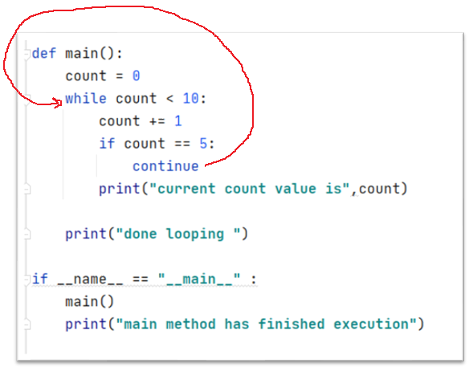
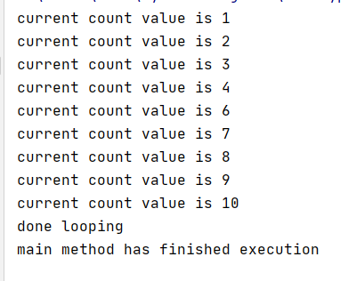
Stopping a while loop
Example of using continue statement to stop the rest of the current iteration, and ask if the loop should continue or not:
Output:

Slide 42
CLI Command Line Interface
A Python program is run from the command-line (i.e., the Windows or Linux command prompt or terminal)
In PyCharm, we have three options to run our programs
PyCharm Console (preferred)
Python Console using runfile () command
Terminal using python command

Slide 43
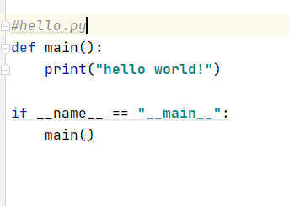
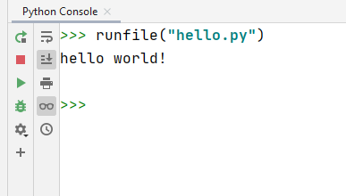
CLI Command Line Interface
Example of running a program from Python console using runfile()
Given the following python script
Running the script from Python console:

Slide 44
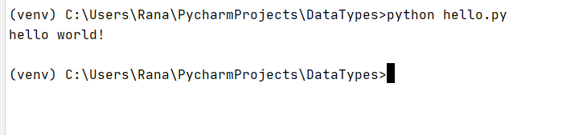
CLI Command Line Interface
Example of running a script from Windows Command Prompt using command python
Given the following python script
Running the script from Windows command Prompt:

Slide 45
Next Week Homework
Review the material.
Complete the lab.
In Python there is a comparison operator (is) and (is not). What is the difference between operators == and is in Python? Quiz question
Read chapter 6: http://do1.dr-chuck.com/pythonlearn/EN_us/pythonlearn.pdf
Prepare for the quiz next week which will be on the topics of this session. (Lesson #3)

